Slide 1
Logic circuits Exercise 3
Student’s name: Anca Alexia Nistor
Group 915

Slide 2
Exercise 3.
Draw a logic circuit having 3 input wires and containing all basic and derived gates. Write the corresponding Boolean function, simplify it and then draw a simplified circuit equivalent to the initial one.

Slide 3
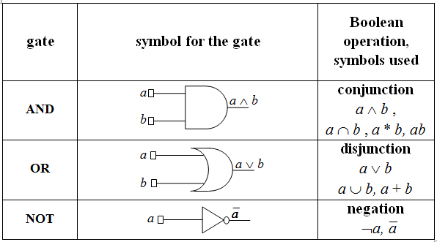
T H E O R E T I C A L P A R T
BASIC GATES: AND, OR, NOT

Slide 4
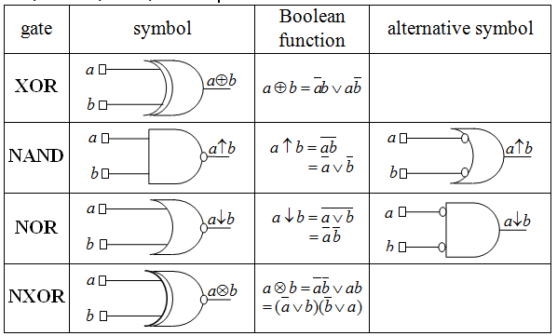
DERIVED GATES: XOR, NAND, NOR, NXOR
T H E O R E T I C A L P A R T

Slide 5
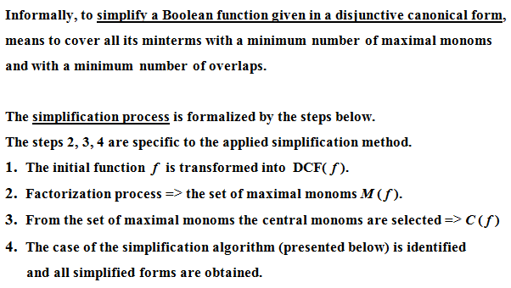
STEPS TO SIMPLIFY A BOOLEAN FUNCTION
T H E O R E T I C A L P A R T

Slide 6
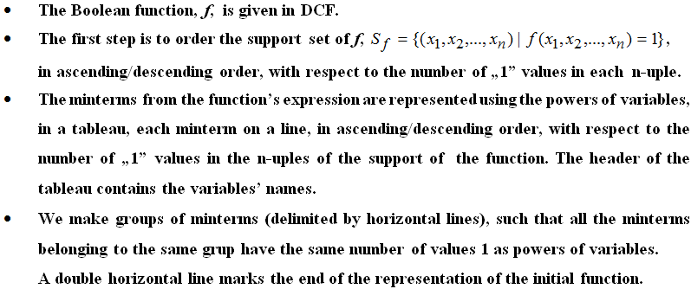
QUINE’S METHOD – DESCRIPTION (I)
T H E O R E T I C A L P A R T

Slide 7
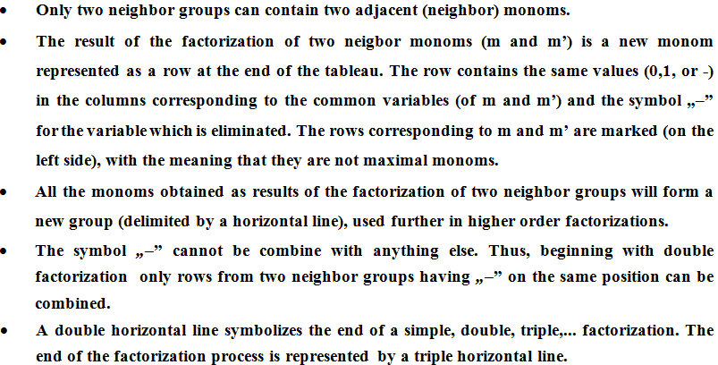
QUINE’S METHOD – DESCRIPTION (II)
T H E O R E T I C A L P A R T

Slide 8
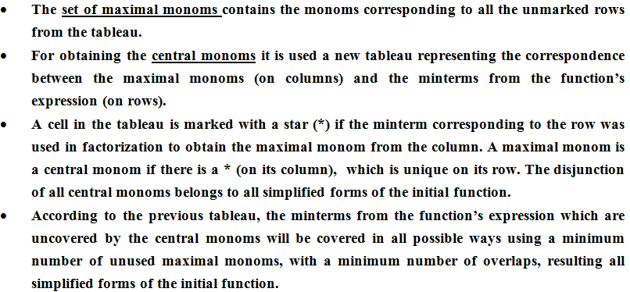
QUINE’S METHOD – DESCRIPTION (III)
T H E O R E T I C A L P A R T

Slide 9
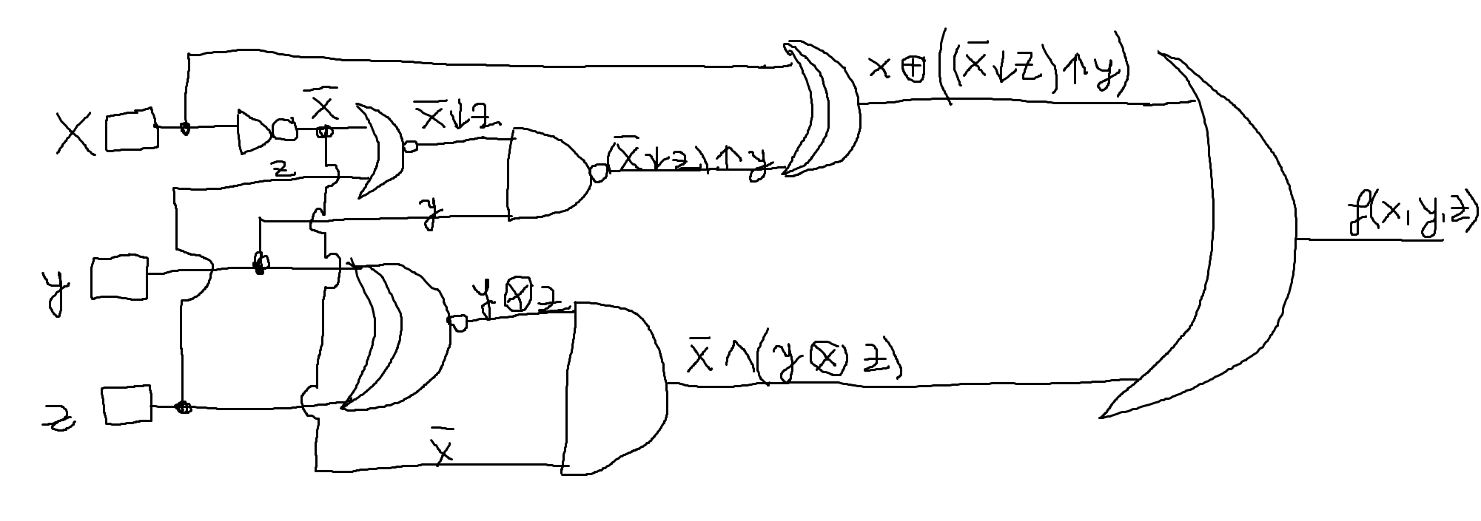
THE LOGIC CIRCUIT:
_
_
=> f(x, y, z) = ( x⊕((x↓z)↑y) )˅(x˄(y z))
⊕

Slide 10
_
_
HERE, WE TRANSFORM f INTO DCF(f).
f(x, y, z) = (x⊕((x↓z)↑y)) ˅ (x˄(y z))
x ↓ z = xz
xz ↑ y = xz ˅ y = x ˅ z ˅ y = x ˅ y ˅ z
x⊕(x ˅ y ˅ z) = x(x ˅ y ˅ z) ˅ x(x ˅ y ˅ z) =
= xx ˅ xy ˅ xz ˅ xxyz = x ˅ xy ˅ xz ˅ xyz
y z = yz ˅ yz
x ˄ (yz ˅ yz) = xyz ˅ xyz
=> f(x, y, z) = x ˅ xy ˅ xz ˅ xyz ˅ xyz ˅ xyz
f(x, y, z) = x ˅ xyz
_
_
⊕
_
_
_
_
_
_
_
_
_
_
_
_
_
_
_
_
_
_
_
_
_
_
_
_
_
_
_
_
⊕
_
_
_
_
_
_
_
_
_
_
_
_
_
_
_
_
_
_
here, we use Absorption Law:
a ¤ (a ⁂ b) = a ⁂ (a ¤ b) = a

Slide 11
_
_
f(x, y, z) = x ˅ xyz = a ˅ b
S = {(0,0,0), (0,0,1), (0,1,0), (0,1,1)}
S = {(1,1,0)}
=> S = {(0,0,0), (0,0,1), (0,1,0), (0,1,1), (1,1,0)}
a
b

Slide 12
x | y | z
0 | 0 | 0
0 | 0 | 1
0 | 1 | 0
0 | 1 | 1
1 | 1 | 0
0 | 0 | -
0 | - | 0
0 | - | 1
0 | 1 | -
- | 1 | 0
0 | - | -
I
II
III
IV = I + II
V = II + III
VI = IV + V
m1
m2
m3
m4
m6
✓
✓
✓
✓
✓
_
_
m1 ˅ m2 = xy = max1
m1 ˅ m3 = xz
m2 ˅ m4 = xz
m3 ˅ m4 = xy = max2
m3 ˅ m6 = yz = max3
_
_
✓
_
✓
_
_
_
m1˅m3˅m2˅m4=x=max4

Slide 13
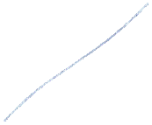





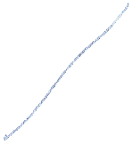










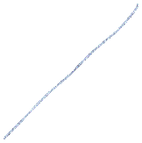


max monoms
 | max1 | max2 | max3 | max4
m1 | * |  |  | *
m2 | * |  |  | *
m3 |  | * | * | *
m4 |  | * |  | *
m6 |  |  | *
minterms
Circled, because it is unique on its row.

Slide 14
From the table, it can be seen that (max3) is the only central monom, because it has at least one ‘*’ which is unique on its row. => C(f) = {max3}.
M(f) = {max1, max2, max3, max4}
C(f) = {max3}
M(f) != C(f) and C(f) is not empty
The second case of simplification algorithm,
g(x,y,z) = max3 = yz.
_

Slide 15
To identify the simplified forms, we have to choose functions h(x,y,z), as simple as possible, such that they cover the minterms m1, m2 and m4, uncovered by g(x,y,z).
We choose the maximal monom having the maximum number of unshaded ‘*’:
max4 = x, so h(x,y,z) = max4
=> fs(x, y, z) = g(x,y,z) ˅ h(x,y, z) =max3 ˅ max4 = yz ˅ x.
_
_
_

Slide 16
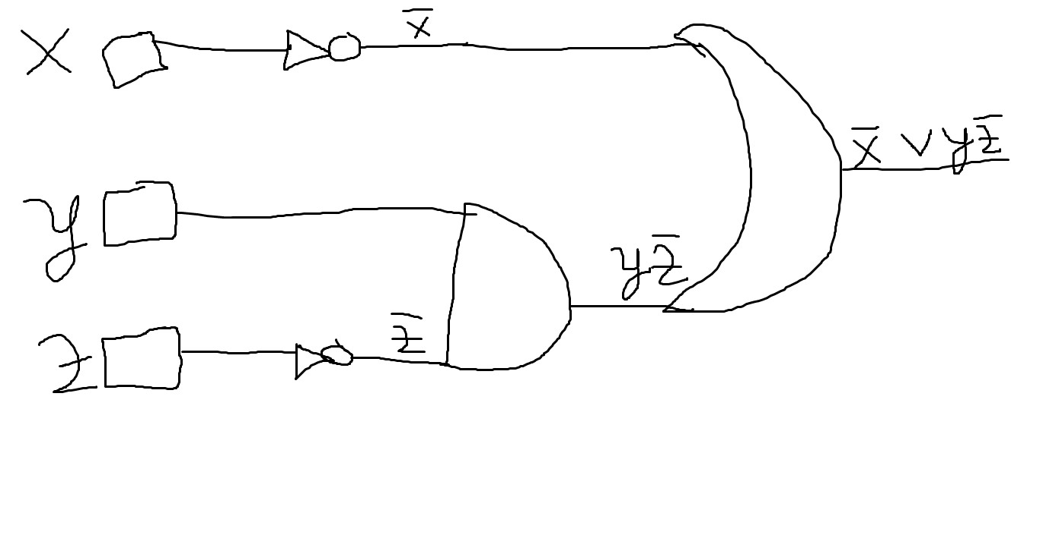
The logic circuit for the simplified form is:

